Slide 1
SEMANTIC_CORPUS
-VAISHNAVI SHARMA

Slide 2
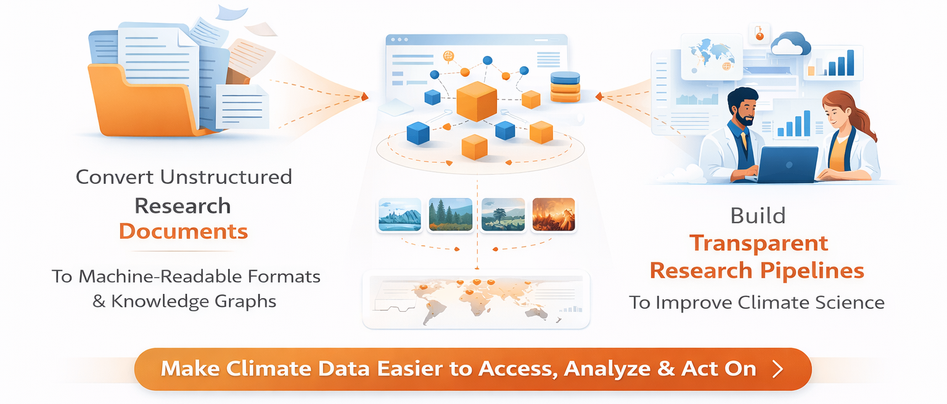
WHAT & WHY?

Slide 3
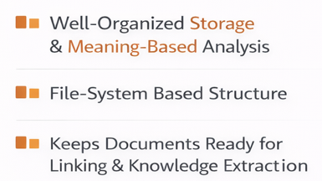
What is a SemanticCorpus?

Slide 4
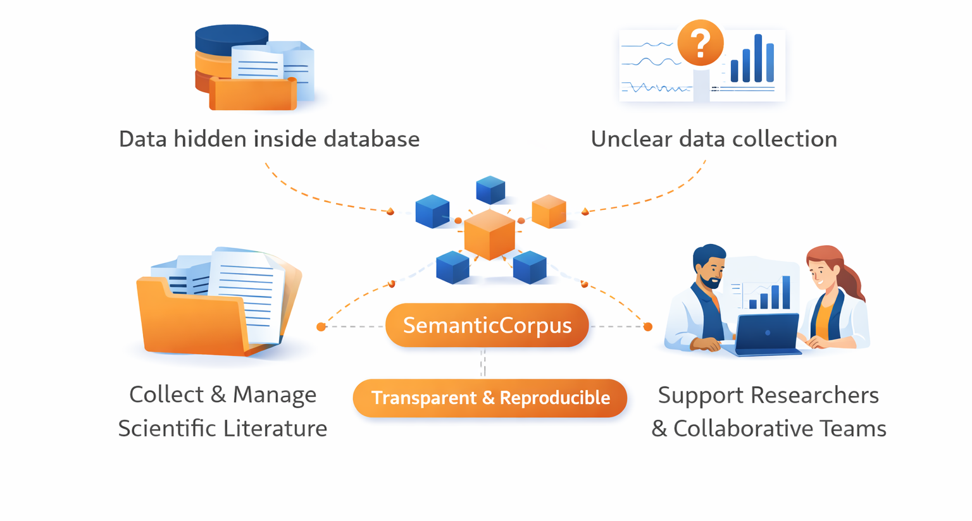
Why SemanticCorpus?

Slide 5
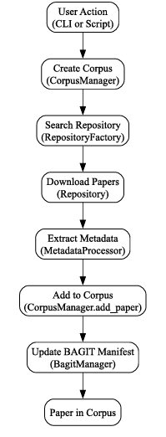
Architecture of SemanticCorpus
Corpus is organized as directories and files.
Each document is stored with metadata and identifiers.
Uses BAGIT specification for integrity and preservation.
Designed to be version controlled (e.g.- GitHub).
Simple folders + standard formats +
BAGIT for reliability + Git for version control

Slide 6
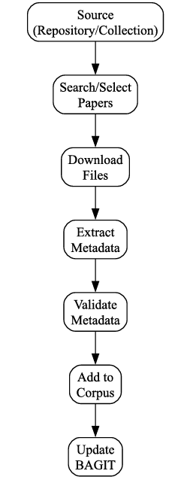
INGESTION
The process of bringing documents into a corpus in a structured, validated, and usable way.
ACTIVE INGESTION
LOCAL INGESTION
-starts with query.
- starts with existing files.

Slide 7
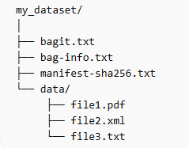
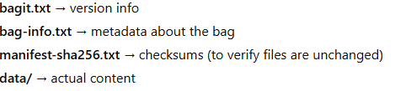
BagIt
BagIt is a standardized file packaging format used to store and transfer digital content reliably, to check if the data is completed and unchanged.
It was developed by the Library of Congress and is widely used in digital archives, research data management, and preservation systems.

Slide 8
GOALS
BAGIT
IMPORT
FEATURE
PDF
IMPORT
FEATURE

Slide 9
THANK YOU!

